Slide 1

Balancing of a single cylinder engine crankshaft
Group Members:
Szabó Vilmos Benedek
Antony Akwalu
Ghofrane Baazaoui
Nipun Gunarathne
Gaurawa Kovida

Slide 2
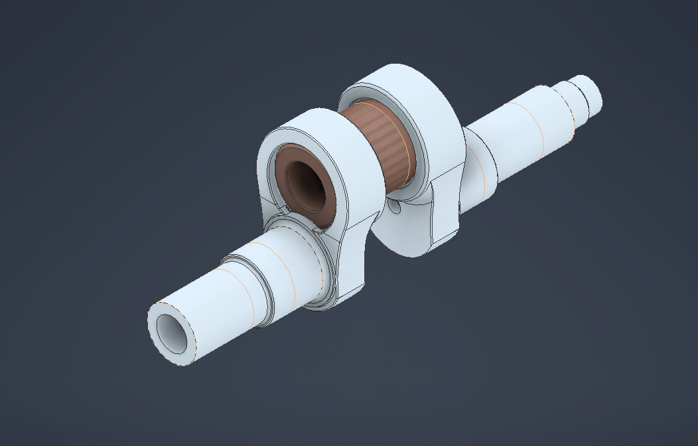
THE PROBLEM…?
At high speeds (6000rpm) the reciprocating piston and rotating crank components generate massive inertia forces.
Without counterweights the engine is in a state of constant acceleration change, creating violent “shaking forces” that threaten the structural integrity.
Mass of the assembled piston: 380g
Length of the conrod: 106.7mm
Mass of the conrod: 330g
COG of the conrod: 33mm

Slide 3
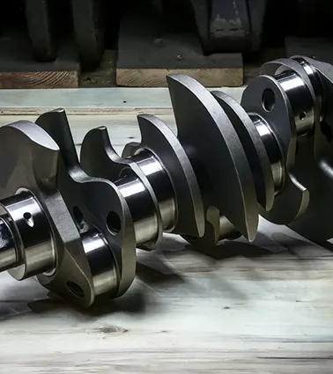
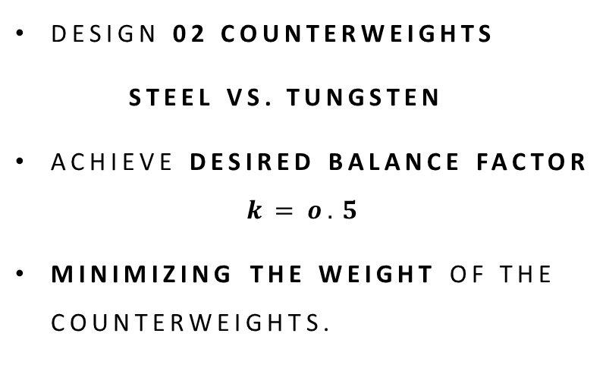
Objective
Design 02 counterweights
steel VS. tungsten
Achieve desired balance factor
$$k=o.5$$
Minimizing the weight of the counterweights.

Slide 4

Theoretical background and software development

Slide 5
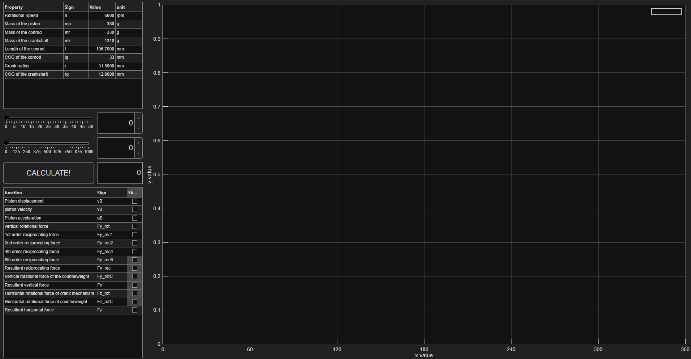
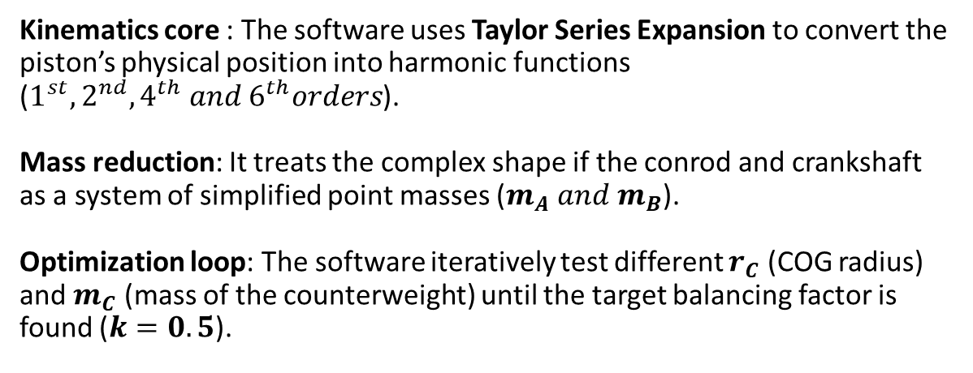
Kinematics core : The software uses Taylor Series Expansion to convert the piston’s physical position into harmonic functions ($1^{st},2^{nd},4^{th} and 6^{th}orders$).
Mass reduction: It treats the complex shape if the conrod and crankshaft as a system of simplified point masses ($m_{A} and m_{B}$).
Optimization loop: The software iteratively test different $r_{C}$ (COG radius) and $m_{C}$ (mass of the counterweight) until the target balancing factor is found ($k=0.5$).
Software’s Interface

Slide 6

Design Strategy

Slide 7
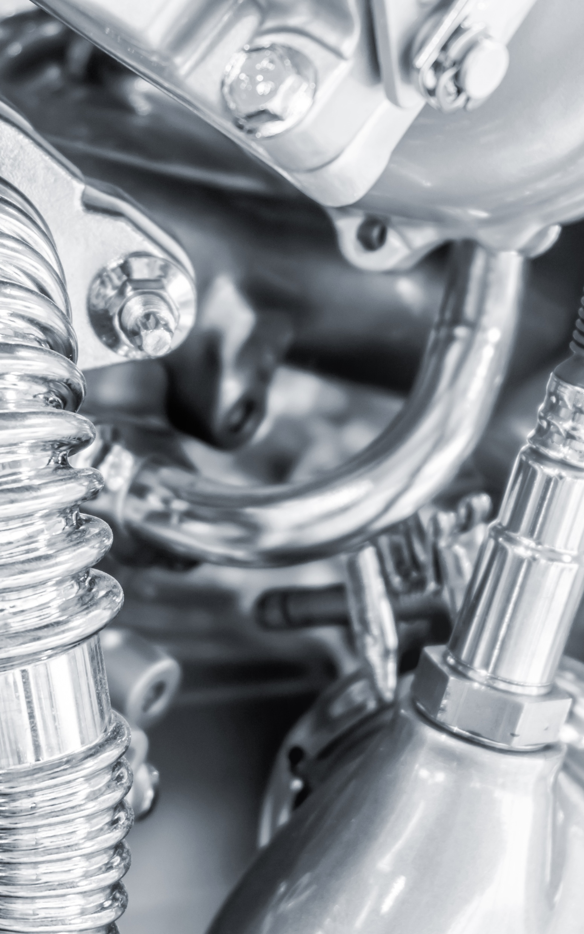
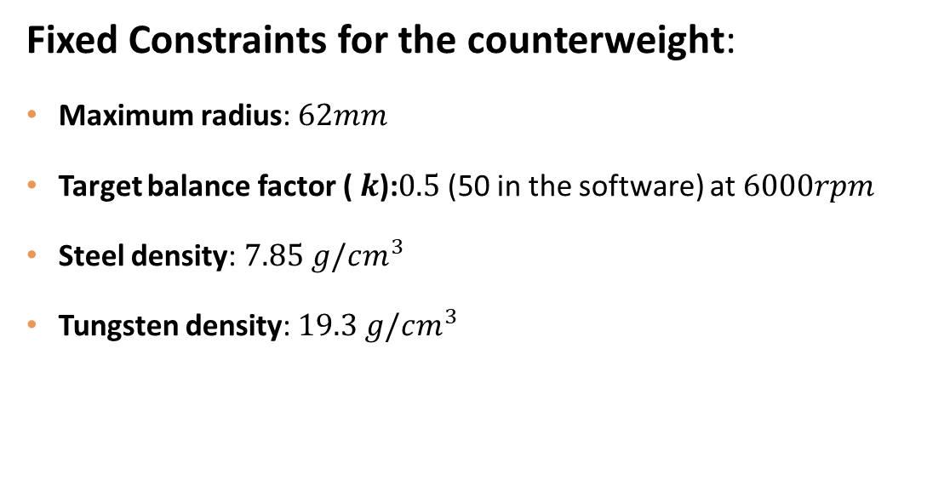
Fixed Constraints for the counterweight:
Maximum radius: $62mm$
Target balance factor ( $k$):$0.5$ (50 in the software) at $6000rpm$
Steel density: $7.85 g/cm^{3}$
Tungsten density: $19.3 g/cm^{3}$

Slide 8
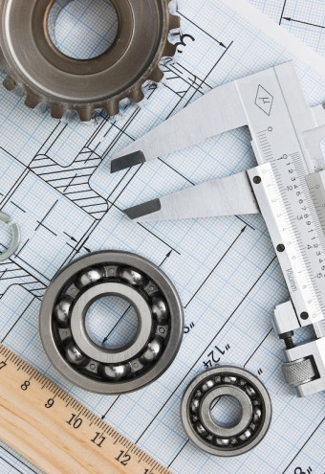
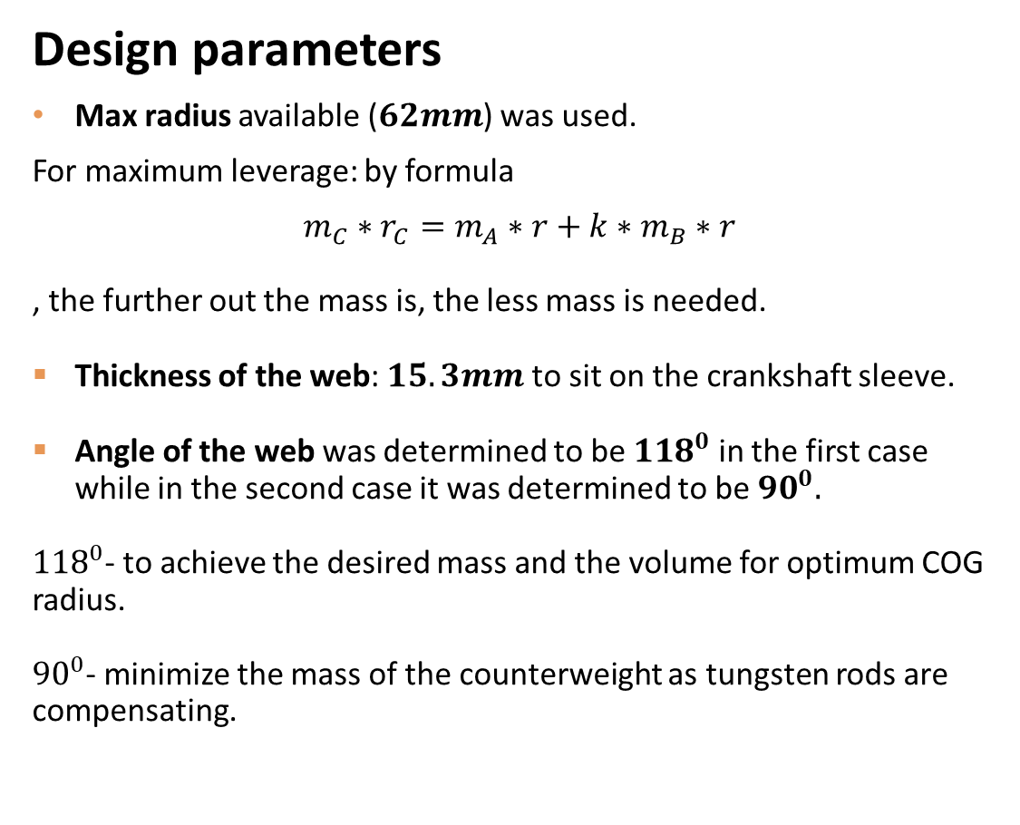
Design parameters
Max radius available ($62mm$) was used.
For maximum leverage: by formula
$$m_{C}∗r_{C}=m_{A}∗r+k∗m_{B}∗r$$
, the further out the mass is, the less mass is needed.
Thickness of the web: $15.3mm$ to sit on the crankshaft sleeve.
Angle of the web was determined to be ${118}^{0}$ in the first case while in the second case it was determined to be ${90}^{0}.$
${118}^{0}$- to achieve the desired mass and the volume for optimum COG radius.
${90}^{0}$- minimize the mass of the counterweight as tungsten rods are compensating.

Slide 9
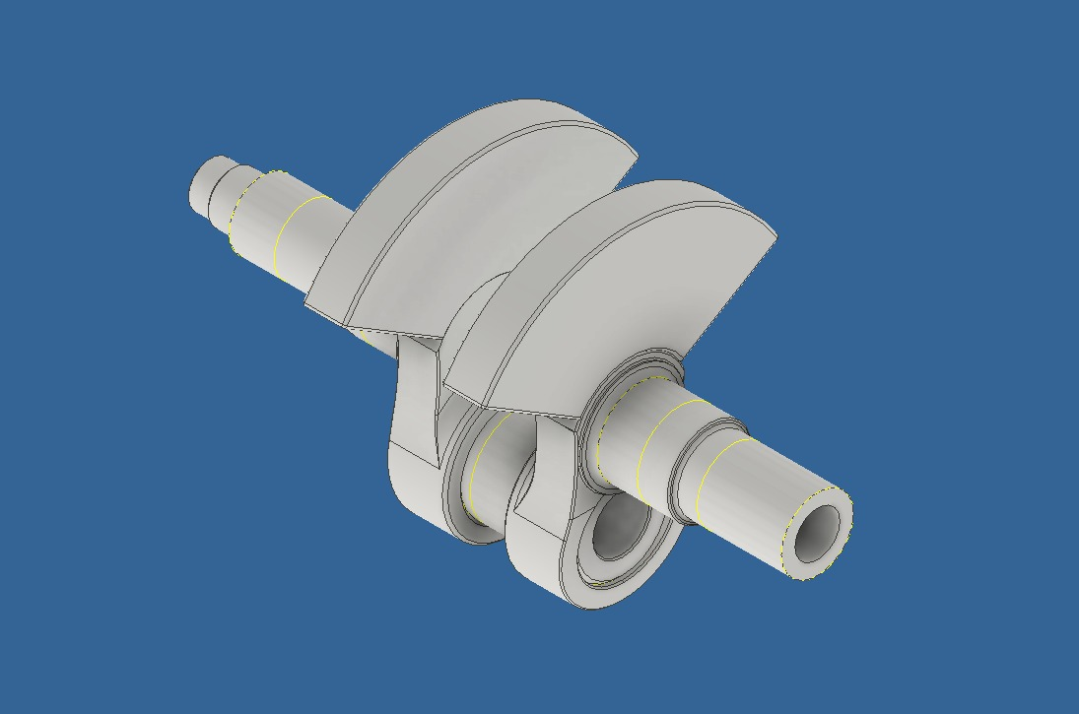
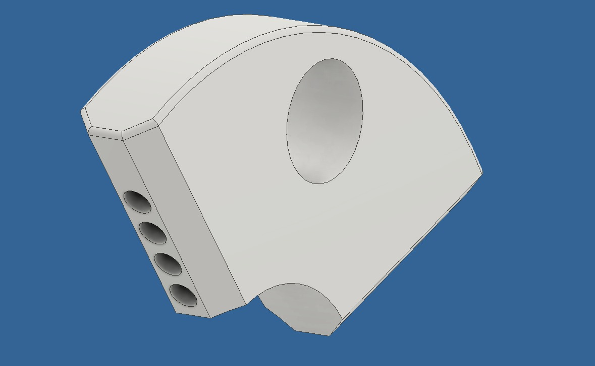
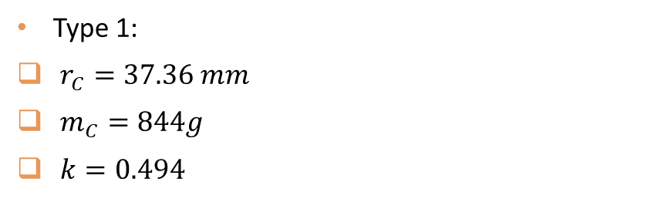
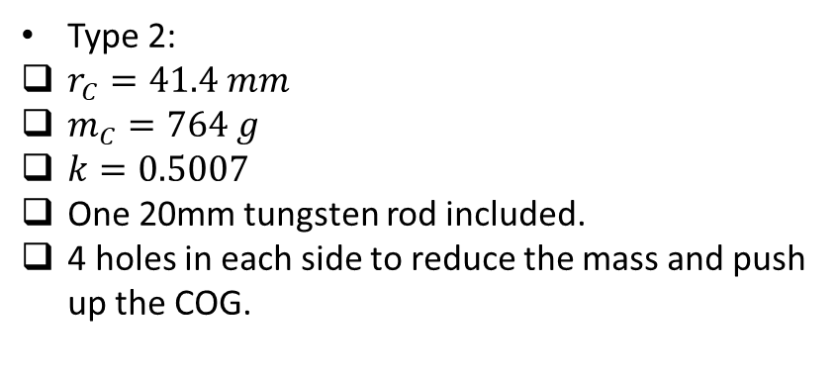
Calculated values through software:
Type 1:
$r_{C}=37.36 mm$
$m_{C}=844g$
$k=0.494$
Type 2:
$r_{C}=41.4 mm$
$m_{C}=764 g$
$k=0.5007$
One 20mm tungsten rod included.
4 holes in each side to reduce the mass and push up the COG.

Slide 10

ASSEMBLIES

Slide 11
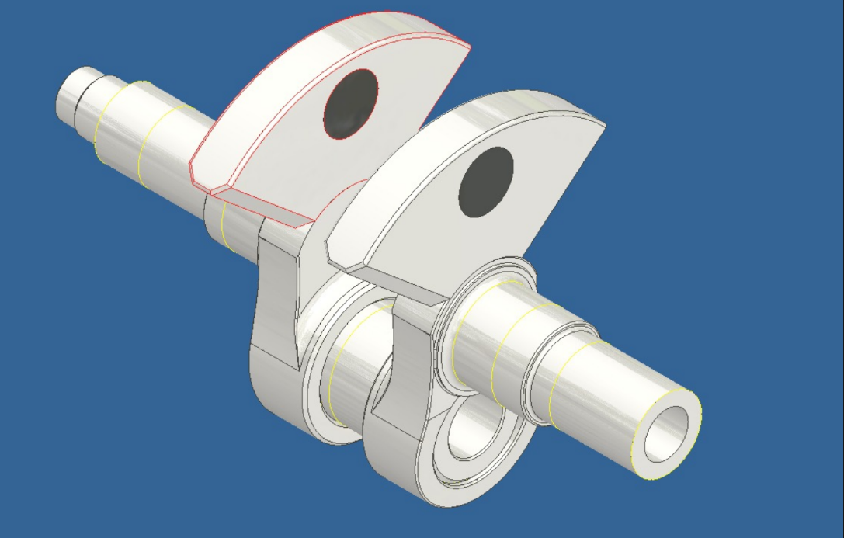
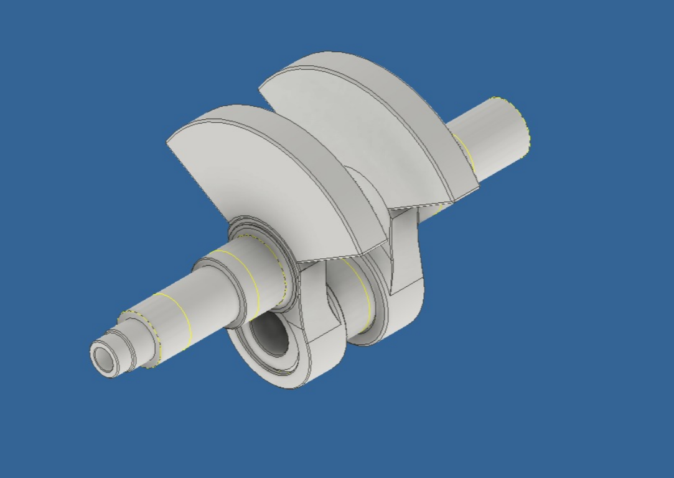
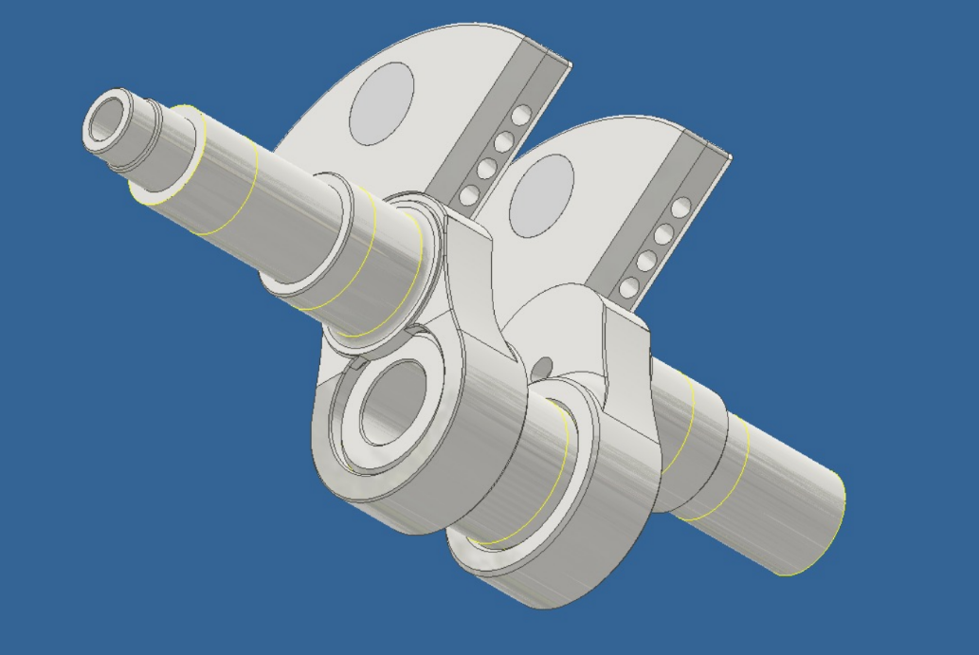
TYPE 2
TYPE 1

Slide 12
PERFORMANCE COMPARISON
TYPE 1 VS. TYPE 2

Slide 13
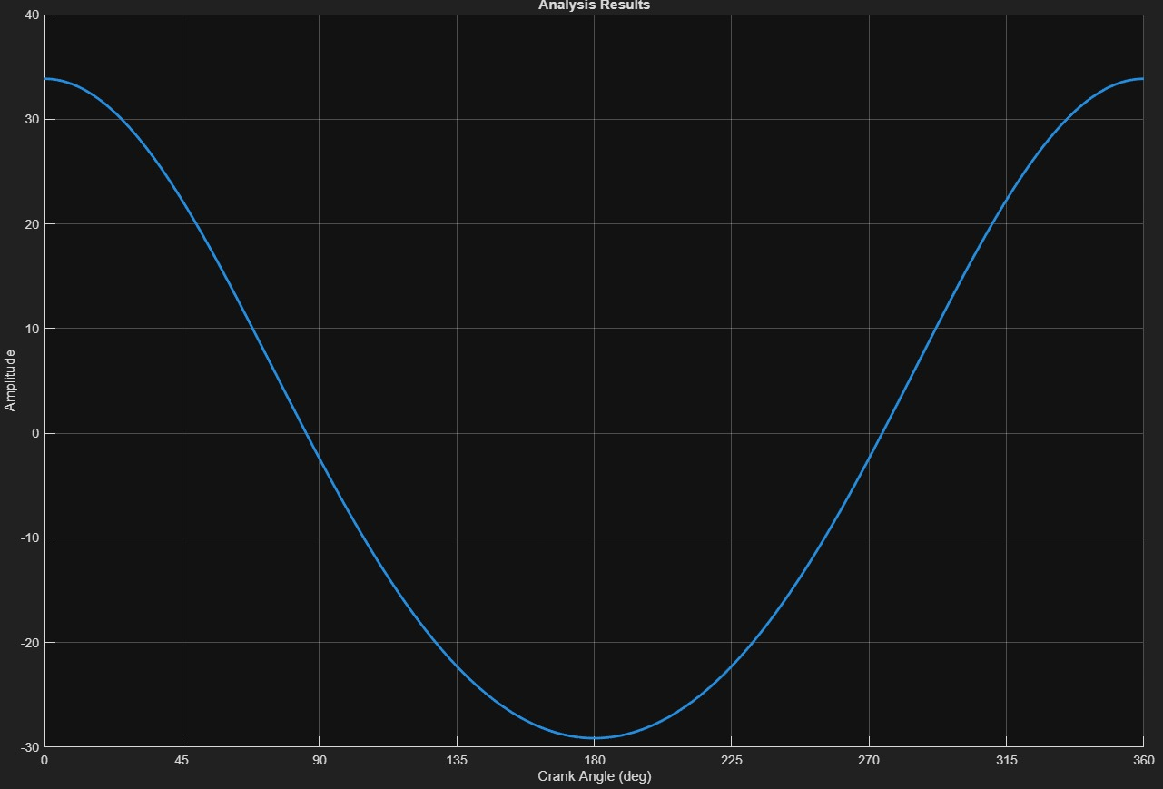
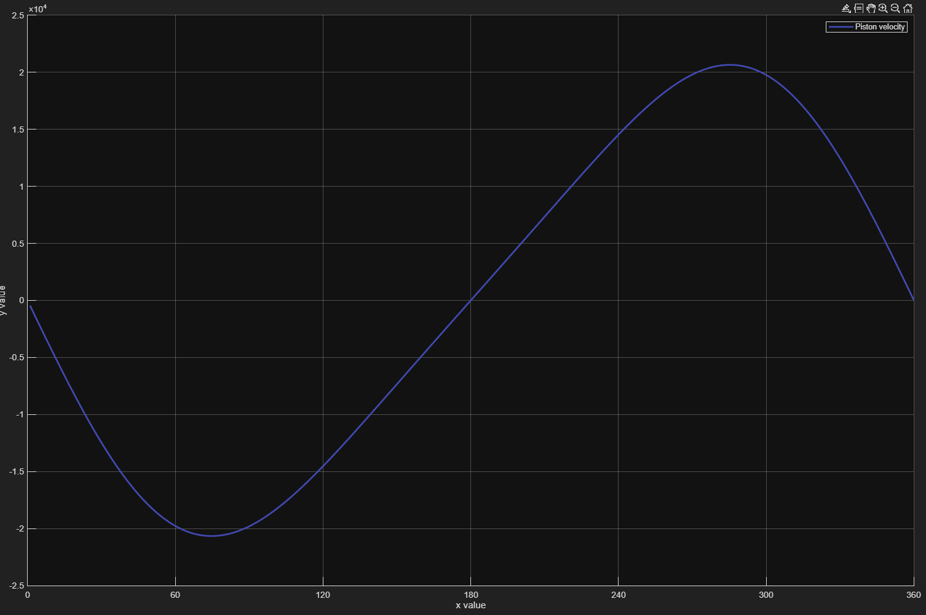
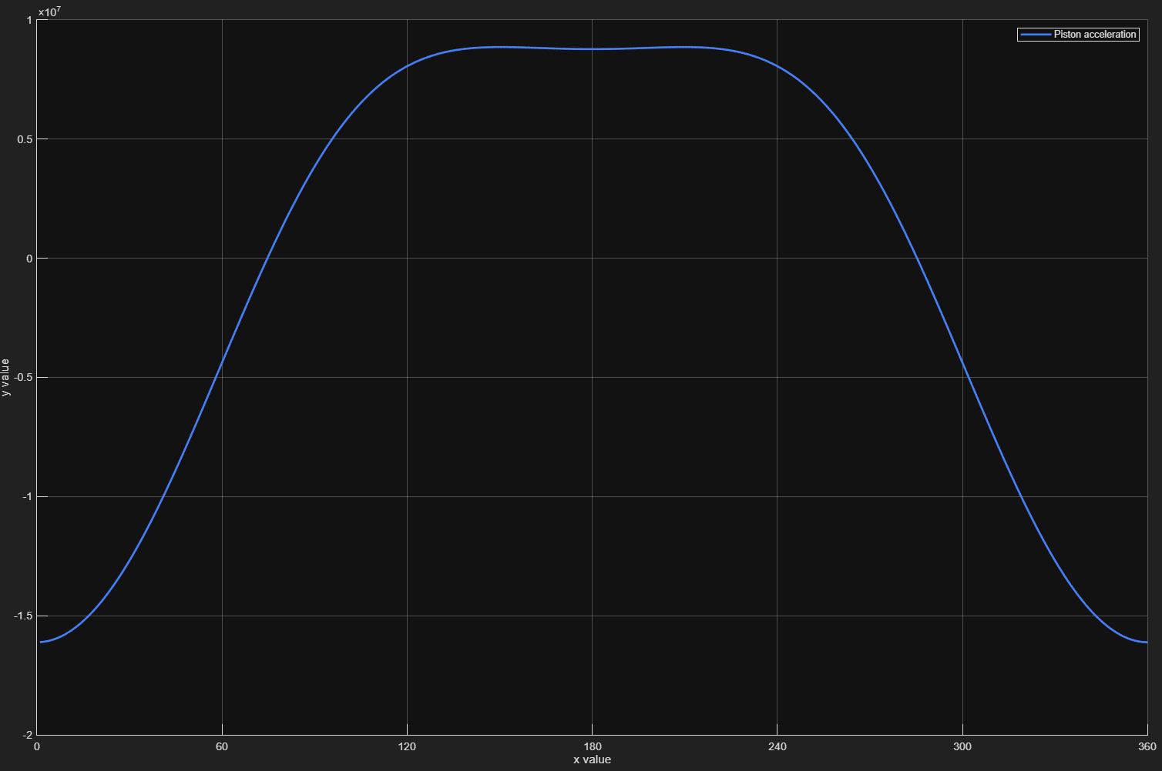
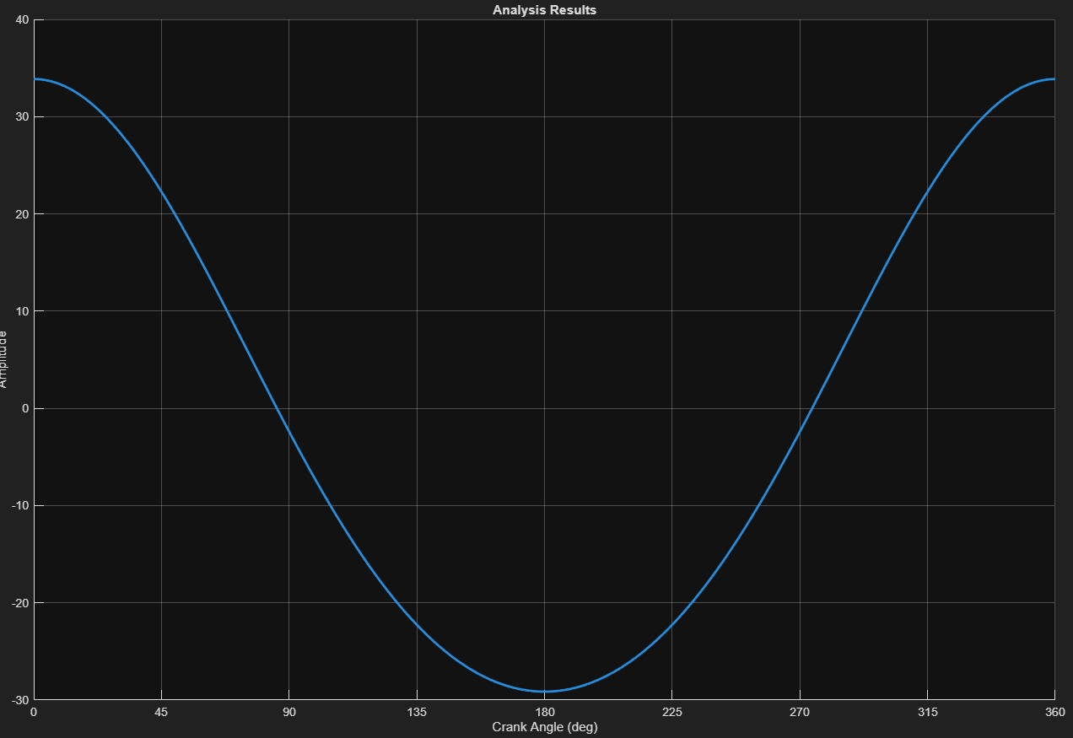
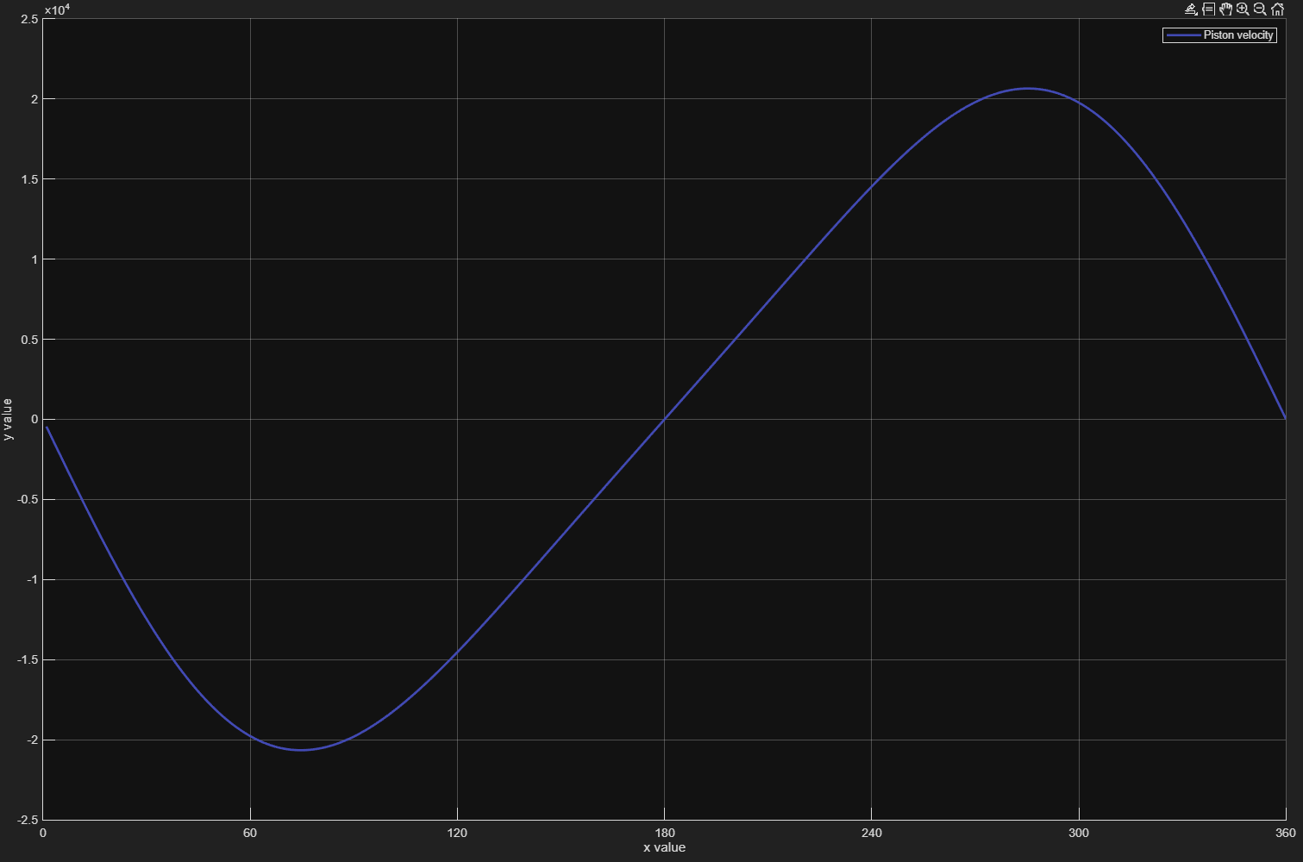

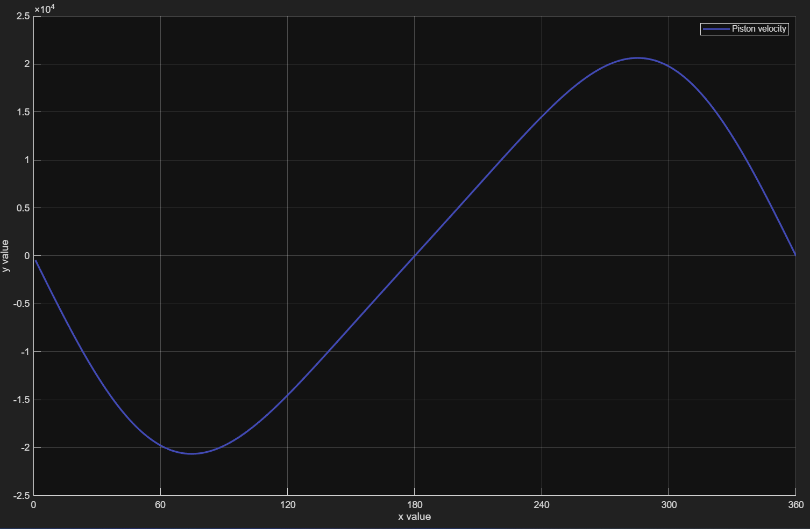
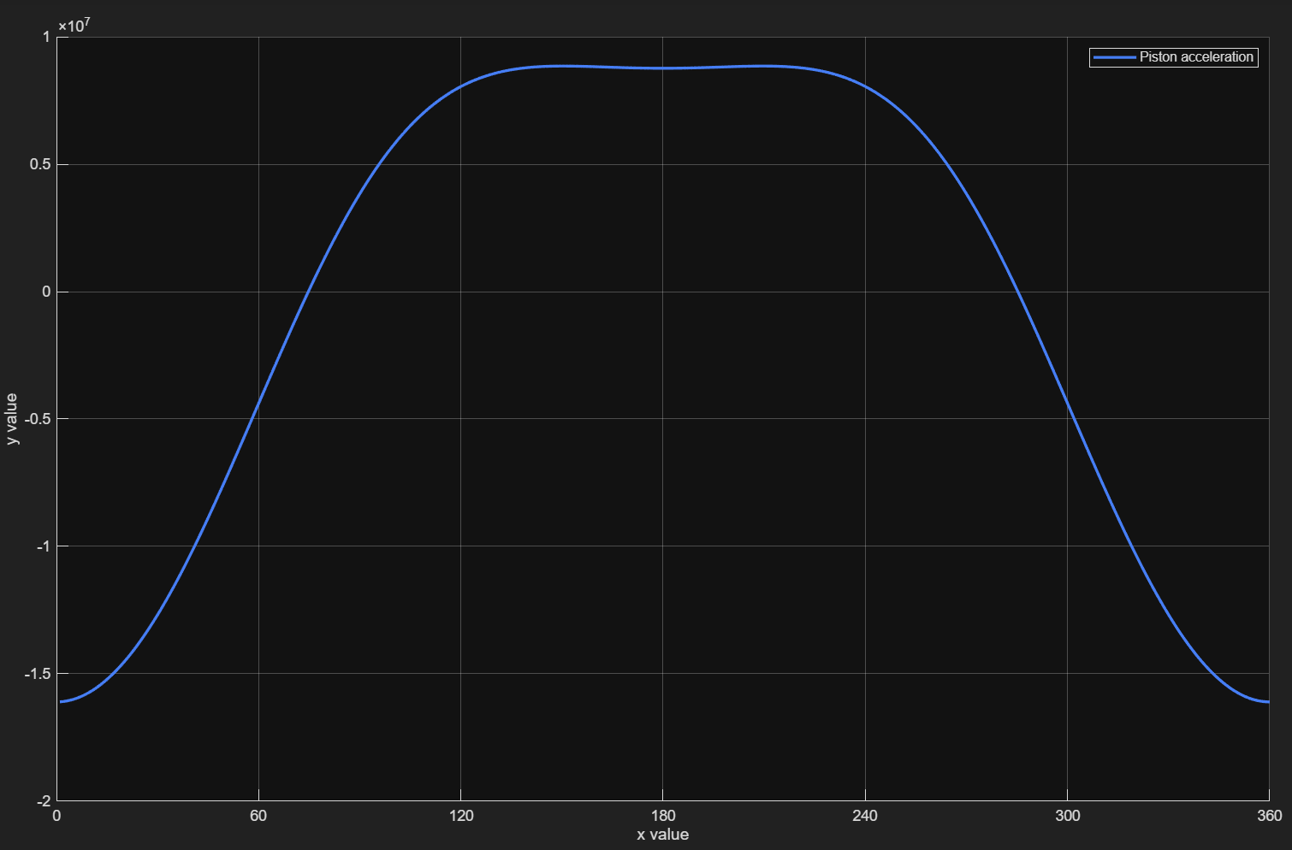
 | Piston Displacement | Piston Velocity | Piston Acceleration
Without Counterweight
Type 1
Type 2

Slide 14
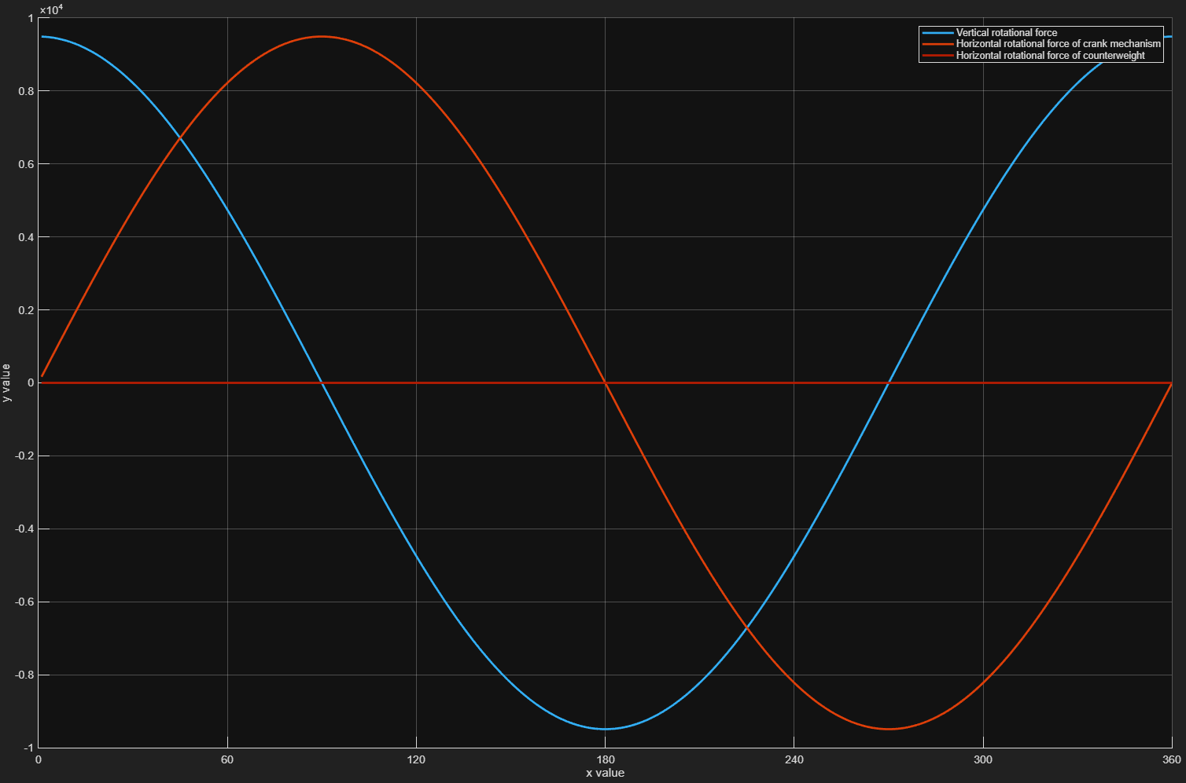
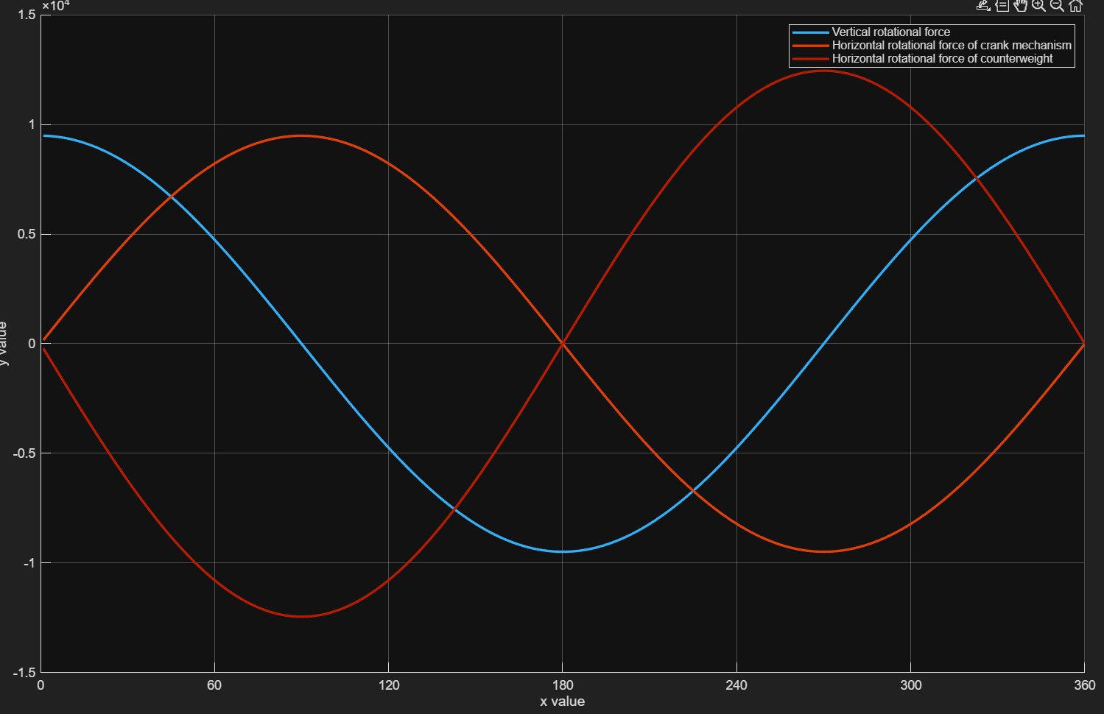
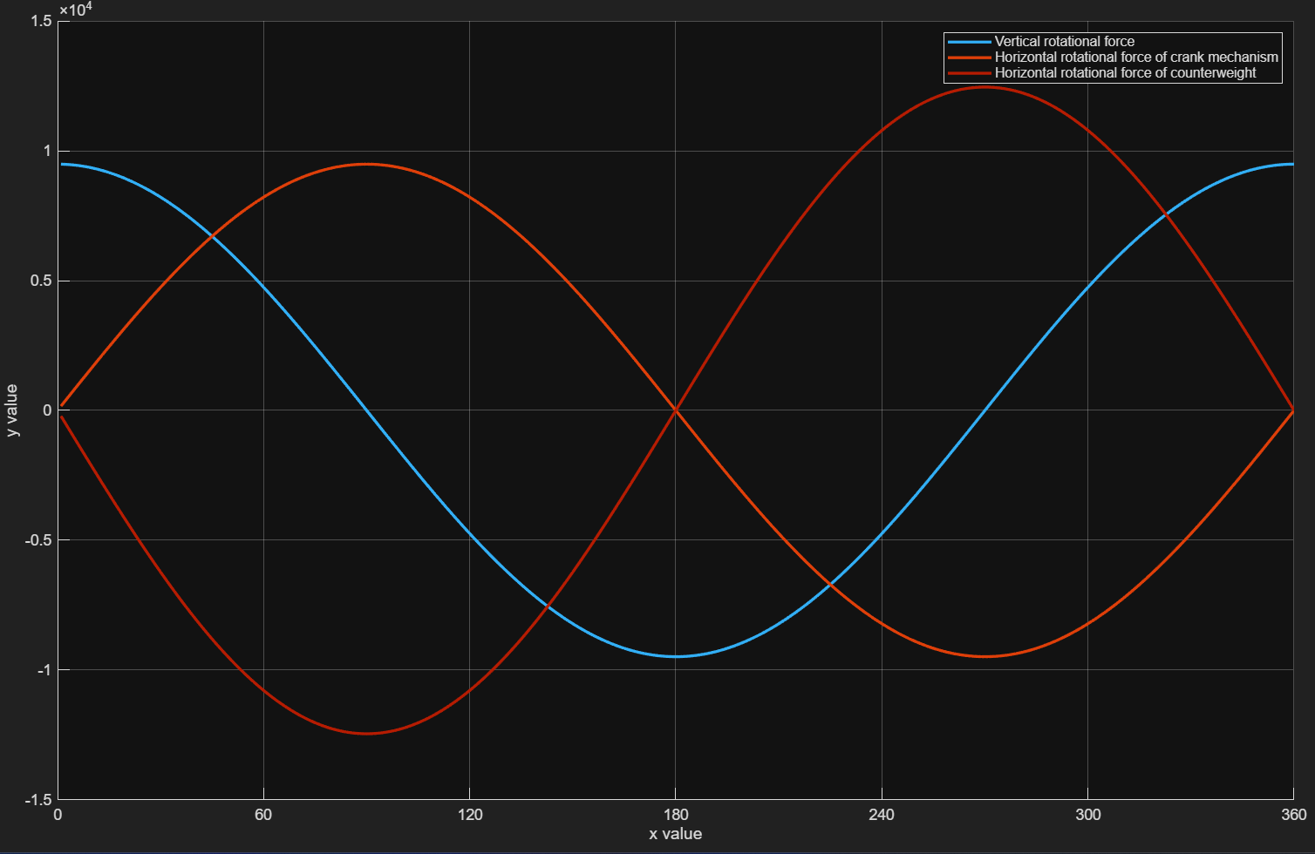
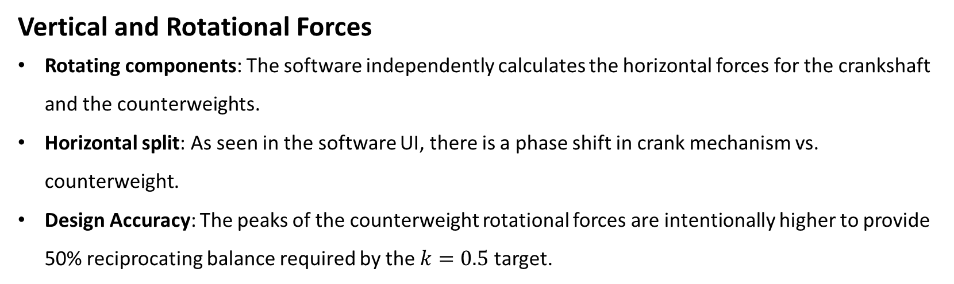
Vertical and Rotational Forces
Rotating components: The software independently calculates the horizontal forces for the crankshaft and the counterweights.
Horizontal split: As seen in the software UI, there is a phase shift in crank mechanism vs. counterweight.
Design Accuracy: The peaks of the counterweight rotational forces are intentionally higher to provide 50% reciprocating balance required by the $k=0.5$ target.
Without counterweight
Type 1
Type 2

Slide 15
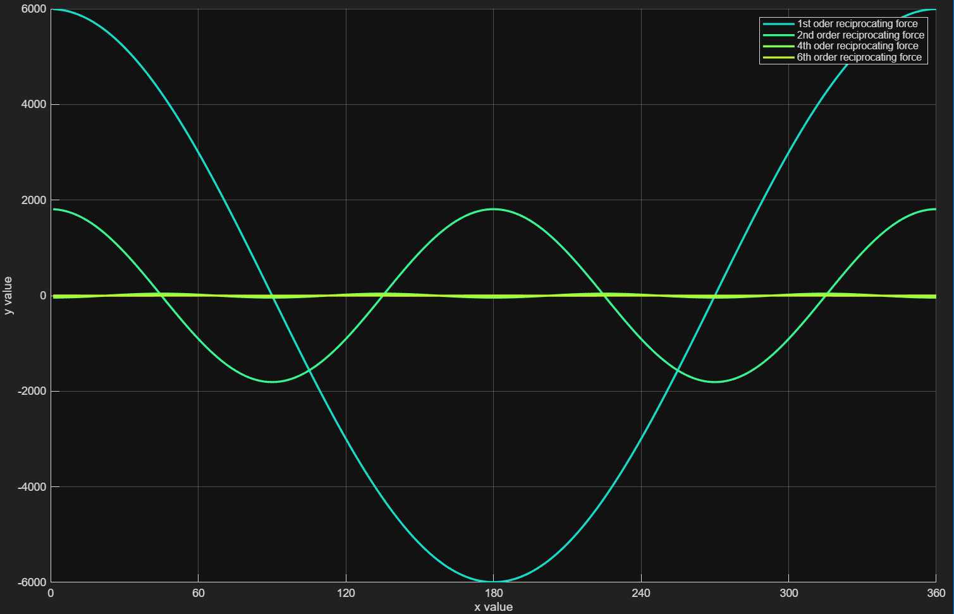
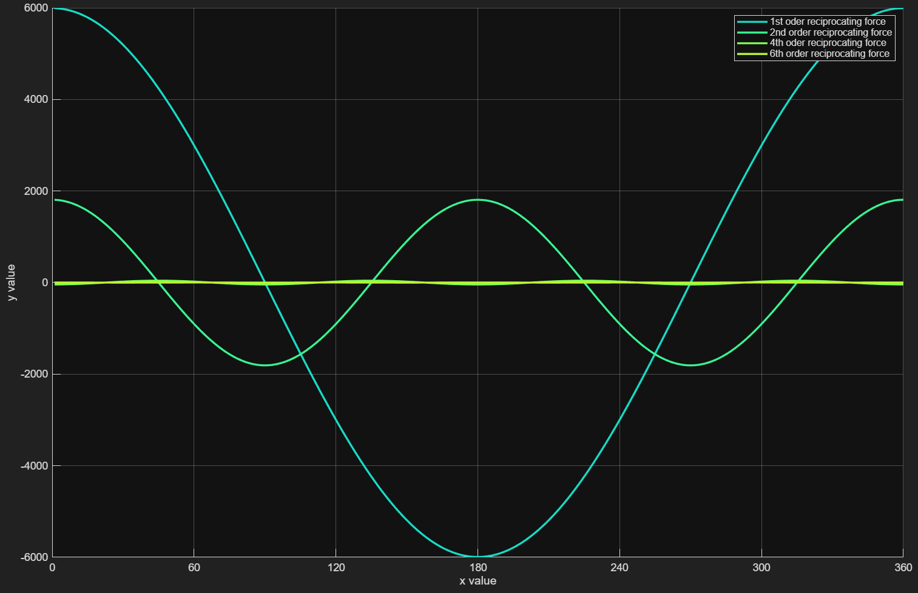
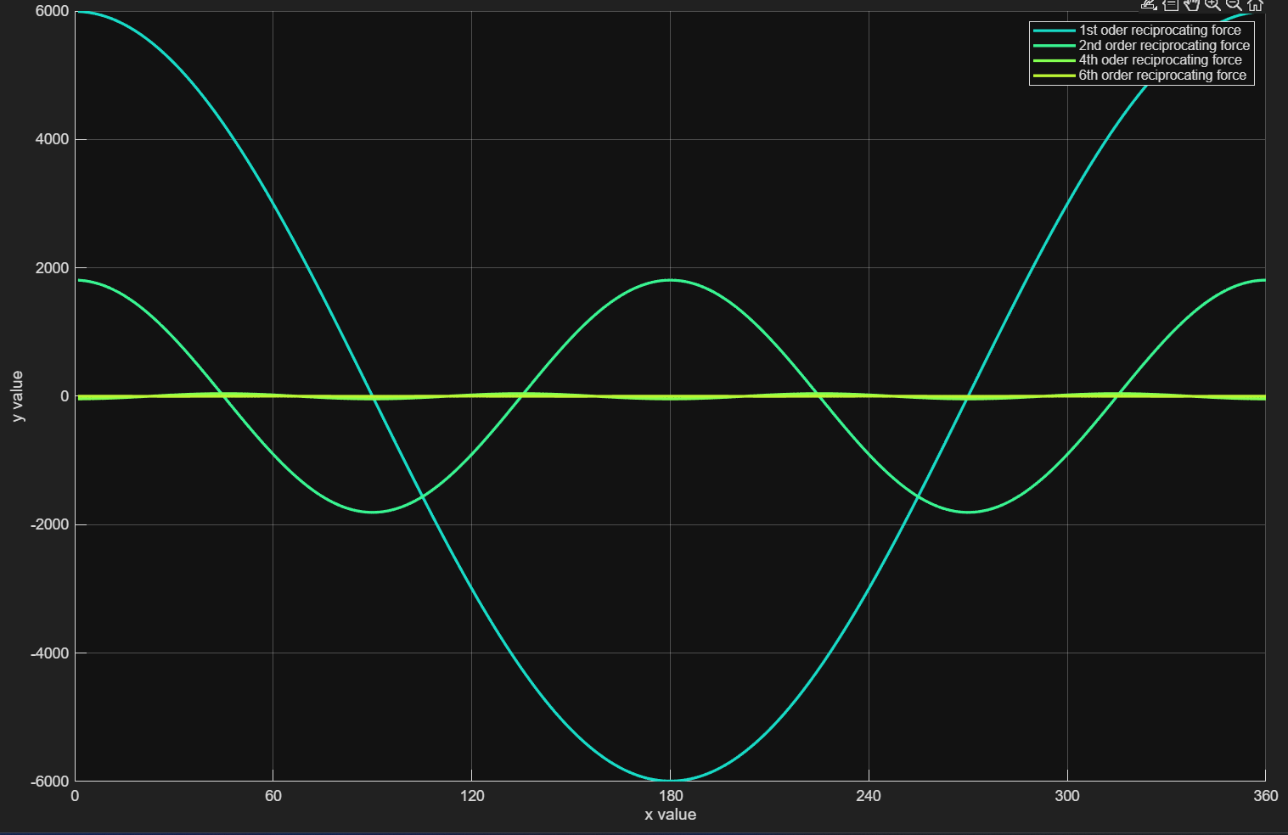
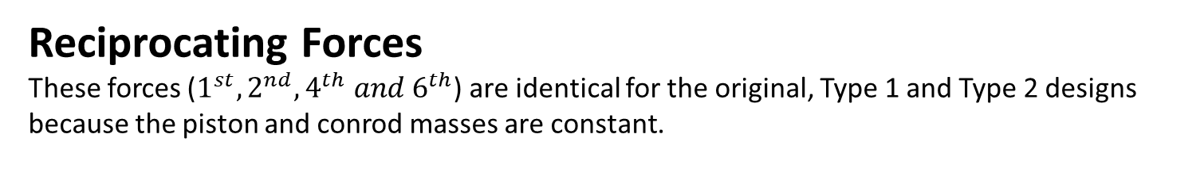
Reciprocating Forces
These forces ($1^{st},2^{nd},4^{th} and 6^{th}$) are identical for the original, Type 1 and Type 2 designs because the piston and conrod masses are constant.
Without counterweight
Type 1
Type 2

Slide 16
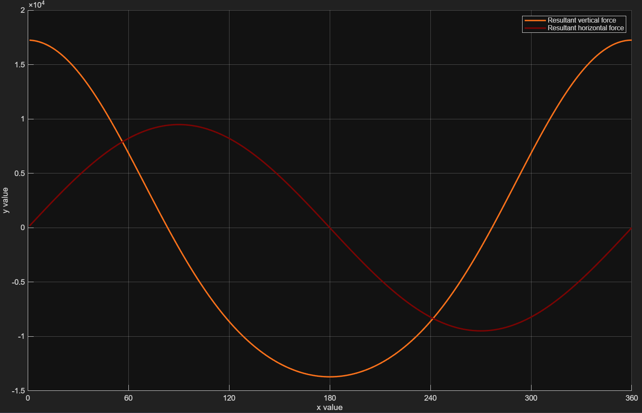
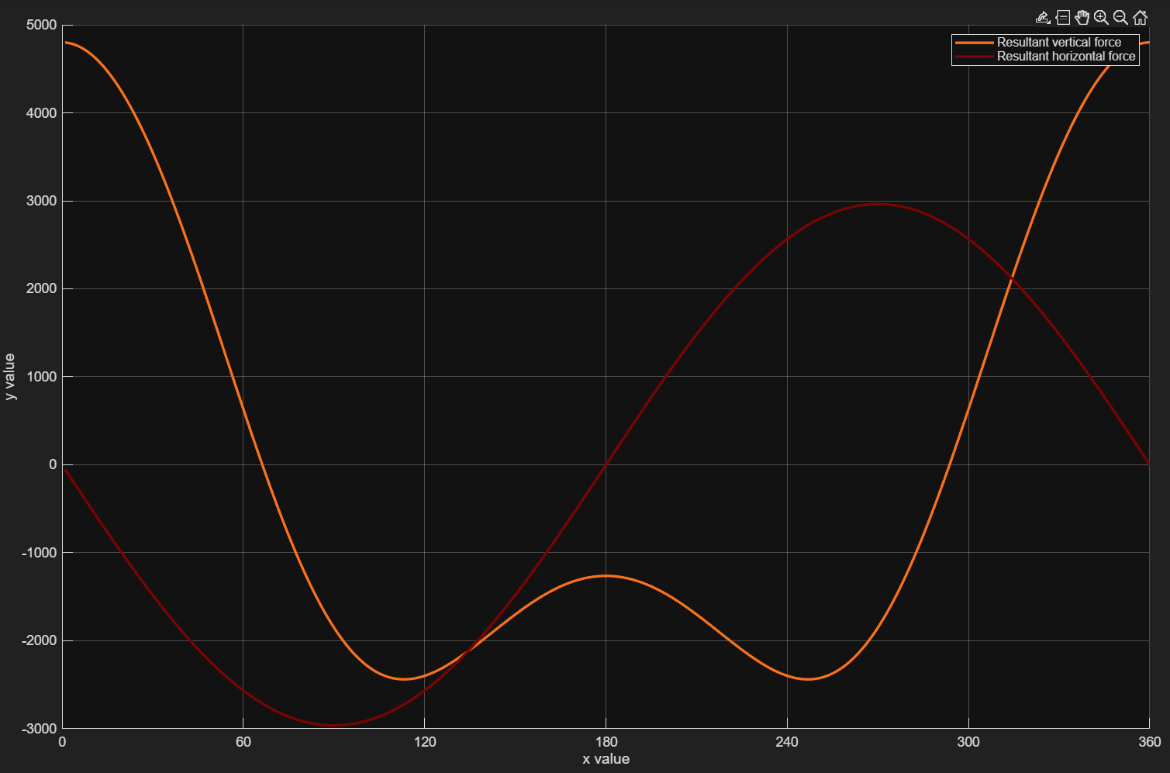
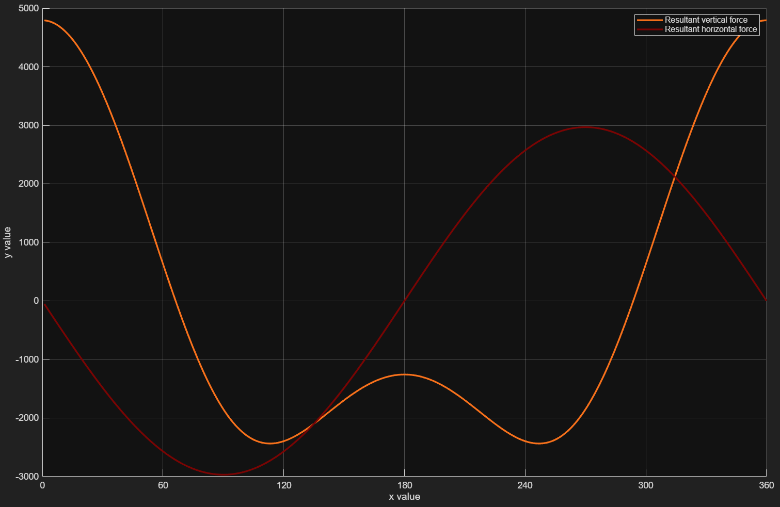
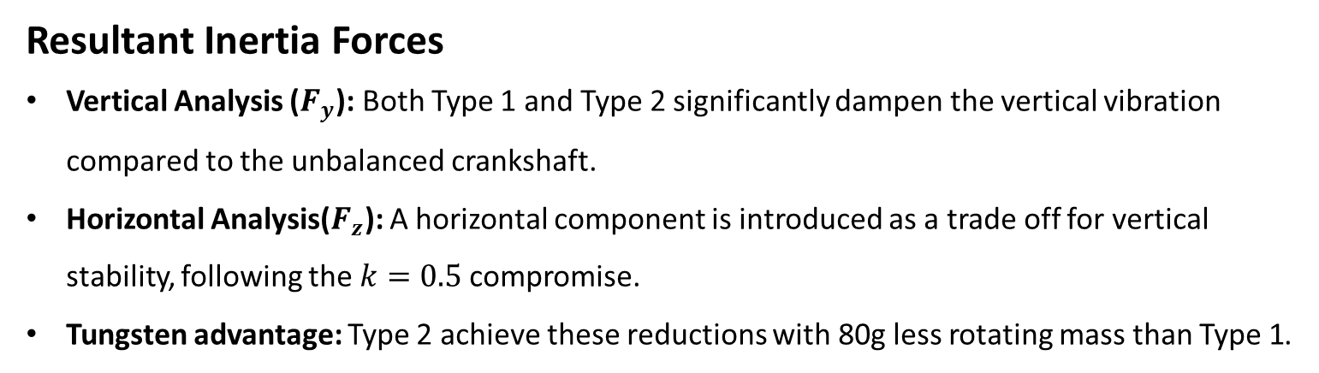
Resultant Inertia Forces
Vertical Analysis ($F_{y}$): Both Type 1 and Type 2 significantly dampen the vertical vibration compared to the unbalanced crankshaft.
Horizontal Analysis($F_{z}$): A horizontal component is introduced as a trade off for vertical stability, following the $k=0.5$compromise.
Tungsten advantage: Type 2 achieve these reductions with 80g less rotating mass than Type 1.
Without counterweight
Type 1
Type 2

Slide 17
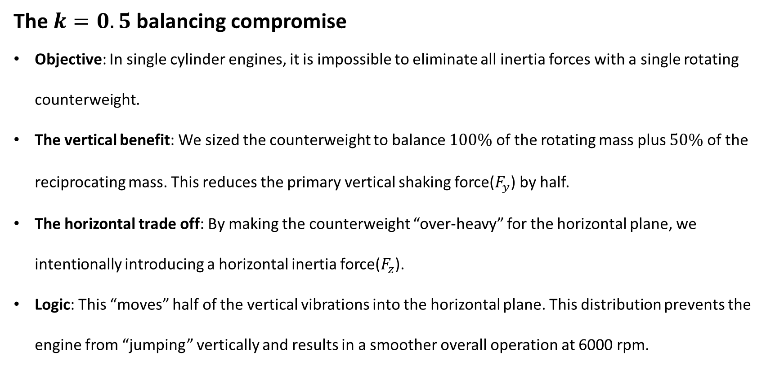
The $k=0.5$ balancing compromise
Objective: In single cylinder engines, it is impossible to eliminate all inertia forces with a single rotating counterweight.
The vertical benefit: We sized the counterweight to balance $100\%$ of the rotating mass plus $50\%$ of the reciprocating mass. This reduces the primary vertical shaking force($F_{y}$) by half.
The horizontal trade off: By making the counterweight “over-heavy” for the horizontal plane, we intentionally introducing a horizontal inertia force($F_{z}$).
Logic: This “moves” half of the vertical vibrations into the horizontal plane. This distribution prevents the engine from “jumping” vertically and results in a smoother overall operation at 6000 rpm.

Slide 18

Project summary and Engineering reflection
Technical Success: Both design types successfully achieved the desired balance between factor of $k=0.5$ within strict geometric constraints ($r_{MAX}=62mm$).
Type 2 efficiency: The tungsten design proved superior, increasing the COG radius from $37.36mm$ (steel) to $41.4mm$, resulting in a $9.7\%$ reduction in total applied mass(from $844g to 764g$).
Mass concentration: Strategic use of $20mm$ tungsten rods and peripheral relief holes allowed for precise static moment tuning with a compact ${90}^{0}$ wedge.
Conclusion: The optimized type 2 design minimizes bearing loads and improves engine responsiveness at 6000 rpm, fulfilling all project objectives.

Slide 19
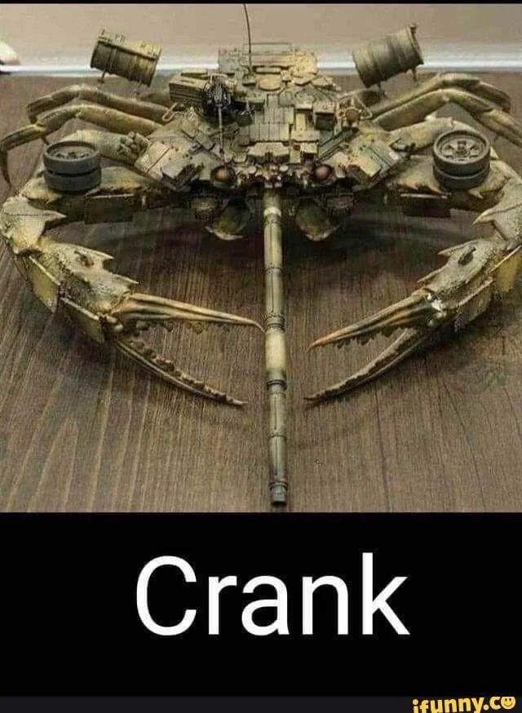
THANK YOU

